Slide 1
IEEE 802.11 Overview and Amendments under development
Overview of the 802.11 Working Group
The IEEE 802.11 standard to date
New Amendments: Markets, use cases and key technologies
2025 January
Presenter:
“At lectures, symposia, seminars, or educational courses, an individual presenting information on IEEE standards shall make it clear that his or her views should be considered the personal views of that individual rather than the formal position, explanation, or interpretation of the IEEE.” IEEE-SA Standards Board Operation Manual (subclause 5.9.3)

Slide 2

IEEE Standards Association
Individual membership
Maintaining
the Standard
Initiating the
Project
7,000+ individual members in 90 countries
Corporate Memberships
Gaining Final
Approval
Mobilizing
the Working Group
  390+ member corporations in 23 countries
Standards Developers
Balloting the
Standard
Drafting the
Standard
  ~20,000 participants;
  all interested parties are welcome

Slide 3
The IEEE 802.11 Working Group is one of the most active WGs in 802
Focus on link and physical layers of the network stack
Leverage IETF protocols for upper layers
OSI Reference
Model
IEEE 802
Local and Metropolitan Area Networks
Standards Committee (LMSC)
Application
Presentation
Session
802.1
Higher
Layer
LAN
Protocols
802.3
CSMA/CD
Ethernet
802.11
Wireless
WLAN
802.15
Wireless
Specialty
Networks
802.16
Wireless
Broadband
Access
802.18
Radio
Regulatory
TAG
802.19
Co-existence
WG
802.21
Media
Independent
Handoff
802.22
Wireless
Regional
Area
Networks
802.24
Vertical
App.
TAG
Transport
Network
Data Link
IEEE
802
MAC/PHY focus
IEEE 802.11 WG Voting Members: 600+
Physical
Medium

Slide 4
IEEE 802.11 Membership
Membership is at an historic high
We shifted from in-person to remote attendance during pandemic
This enabled easy attendance from anywhere in the world
We now run meetings with both in-person and remote attendance
Membership is gained by attendance
Membership is maintained through attendance and ballot participation
Aspirant | Potential Voter | Voter
99 | 52 | 600+
January 2025
4

Slide 5
Development of the IEEE 802.11 Standard is ongoing since 1997
802.11-1997
802.11-1999
802.11-2003
802.11-2007
802.11-2012
802.11-2016
802.11-2020
802.11-2024
11d
Intl Roaming
11e
QoS
11k
RRM
11s
Mesh
11aa
Video Transport
11aq
Pre-association Discovery
11bc
Broadcast Services
MAC
11h
DFS & TPC
11u
WIEN
11v
WNM
11ae
QoS Mgt Frames
11ak
General Link
11i
Security
11z
TDLS
11r
Fast Roam
11ax
High Efficiency WLAN
11ai
Fast Initial Link Setup
11f
Inter AP
11w
Management Frame Security
11ay
Enhanced mmWave
11az
Enhanced Positioning
11n
High Throughput (>100 Mb/s)
11af
TV Whitespace
PHY & MAC
11ba
Wake-up Radio
11a
OFDM
54 Mb/s in 5 GHz
11g
54 Mb/s in 2.4 GHz
11ac
VHT
> 1 Gb/s in 5 GHz
11p
WAVE
11ah
Sub-1 GHz
11bb
Light Communications
11b
HR/DSSS
11 Mb/s in 2.4 GHz
11j
JP bands
11y
Contention Based Protocol
11ad
VHT
> 1 Gb/s in 60 GHz
11aj
China mmWave
11bd
Next Gen V2X
Notes:
doc.: IEEE 802.11-11/0483r0
May 2011
Bruce Kraemer (Marvell)
Page 5
The 802.11 Working Group was established in 1990. The first standard was published in 1997 (2.4GHz) supporting 1 and 2 Mbps. Subsequent amendments and revisions have increased radio performance and throughput by orders of magnitude.
The 802.11b 11Mbps standard was the first to achieve commercial success, with the announcement by Steve Jobs at MACWorld in 2001 that the MACbook would include 802.11 radios, along with the Apple Airport. PC vendors followed suit. Describe highlights of each revision.

Slide 6
New 802.11 Radio technologies are under development to meet expanding market needs and leverage new technologies. Completed standards
IEEE Std 802.11-2020 Revision project
IEEE Std 802.11ax-2021 – Increased throughput & efficiency in 2.4, 5 (and 6) GHz bands
IEEE Std 802.11ay-2021 – Support for 20 Gbps in 60 GHz band
IEEE Std 802.11az-2022 – 2nd generation positioning features
IEEE Std 802.11ba-2021 – Wake up radio. Low power IoT applications
IEEE Std 802.11bb-2023 – Light Communications
IEEE Std 802.11bc-2023 – Enhanced Broadcast Service
IEEE Std 802.11bd-2022 – Enhancements for Next Generation V2X
IEEE Std 802.11be-2024 – Enhancements for extremely high throughput (EHT)
IEEE Std 802.11bh-2024 – Operation with Randomized and Changing MAC Addresses
Notes:
The standard and amendments listed in green are approved and published.
The others are under development, link in the title is to the 802.11 website, where you can obtain more information.
All IEEE 802 standards are available for free 6 months after publication at the IEEE get802 website.
802.11-2020 is the current base standard, although 802.11-2024 is scheduled to be published in January 2025.

Slide 7
Market demands and new technology drive IEEE 802.11 innovation
Demand for throughput
  Continuing exponential demand for throughput (802.11be and 802.11bn)
  Most (50-80%, depending on the country) of the world’s mobile data is carried on 802.11 (Wi-Fi) devices
New usage models / features
  Dense deployments (802.11be), Indoor Location (802.11az, 802.11bk),
  Automotive (802.11bd, AUTO)
  WLAN Sensing (802.11bf)
Technical capabilities
  Millimetric (42-71 GHz) radios (802.11bq)
Changes to regulation
  6 GHz (802.11be)
  Coexistence and radio performance rules (e.g., ETSI BRAN, ITU-R)
Notes:
This summarizes the market demands - what are the market forces and new technology that underpin innovation in 802.11.
First and foremost, the demand for increased throughput are never-ending. AX, AY, BE support this.
Most of world’s mobile data are carried by wi-fi devices that connected to access networks. New usage models and features, motivates new amendments. Such as Dense Deployments, Indoor location, Automotive, Low Power applications.
Increase in technical capabilities also drives new standards. Technologies like MIMO and OFDMA are incorporated into new standards when they are available.
So does changes to regulation that enable development for new standards.

Slide 8
IEEE 802.11 Standards Pipeline – January 2025
REVmf
802.11
-2024
MAC
AUTO TIG
802.11bi
EDP
802.11bh
RCM
WNG
802.11bn
UHR
802.11bk
320 MHz Pos
802.11be
EHT
ELC SG
802.11bp
AMP
802.11bf
SENS
PHY
802.11bq
IMMW SG
Liaison Topics
Discussion Topics
TIG/Study
groups
TG without
Approved draft
WG
Letter Ballot
SA
Ballot
Published
Amendment
Published
Standard
Notes:
doc.: IEEE 802.11-11/0483r0
January 2011
Bruce Kraemer (Marvell)
Page 8

Slide 9
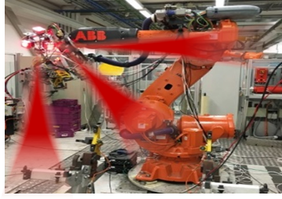
New 802.11 Radio technologies are under development to meet expanding market needs and leverage new technologies.
802.11bf – WLAN Sensing
802.11bi – Enhanced Data Privacy
802.11bk – 320 MHz Positioning
802.11bn – Ultra High Reliability
802.11bp – Ambient Power for IOT
802.11bq – Integrated Milli Metric Wave
ELC – Enhanced Light Communication Study Group
AUTO – Automotive Topic Interest Group
AI / ML – Artificial Intelligence / Machine Learning Group
Notes:
This is a list of the amendments that are currently under development in the 802.11 Working Group.
The next slides will present a brief overview of the 802.11 standards that are under development.

Slide 10
Wi-Fi standard evolution: 802.11bn is now under development
Project | Industry Name | Defining features
802.11n High Throughput | Wi-Fi 4 | Spatial multiplexing, 40 MHz channels, beamforming, A-MPDU
802.11ac Very High Throughput | Wi-Fi 5 | 80 MHz & 160 MHz channels, beamforming that works Enabled broad support for 5 GHz band operation
802.11ax High Efficiency | Wi-Fi 6 and 6E | Multi-user operation, 320 MHz channels, 6 GHz band operation
802.11be Extremely High Throughput | Wi-Fi 7 | Multi-link operation (simultaneous use of multiple channels)
802.11bn Ultra-High Reliability | Wi-Fi 8* | Lower latency, longer range, faster handover
Completed
Recently approved
New
*Expected name; will be decided outside of IEEE 802.11

Slide 11




802.11bn: Ultra High Reliability (UHR)
Expected to be the basis for Wi-Fi 8
Currently developing their specification framework document (SFD) : Expected improvements:
  Reduce tail latency
  Reduce roaming latency by taking advantage of multi-link features
  Allow access on secondary channel while primary channel is busy
  AP power save
  Security enhancements, e.g., Control frame protection
  Extend range by reducing sensitivity gap between client and AP
  Multi-AP coordination
Longer Range
Higher Throughput
Work beyond 11be
Backwards Compatibility
Positioning

Slide 12
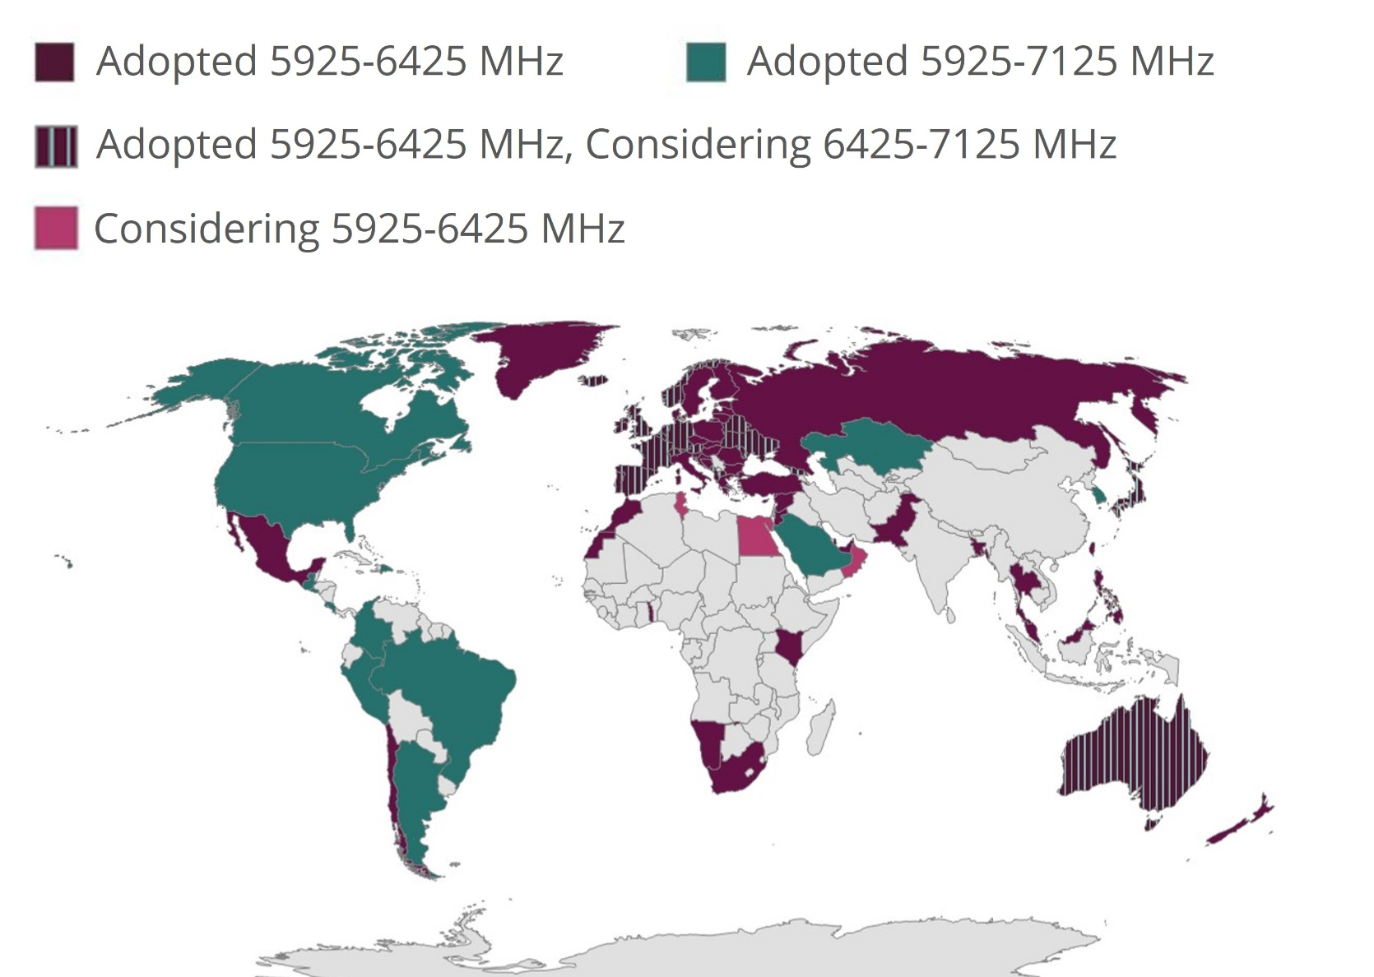
Countries enabling Wi-Fi 6 GHz Operation, see https://www.wi-fi.org/regulations-enabling-6-ghz-wi-fi (as of 2025-01-06)
Notes:
The map shows the countries that have enabled or are considering enabling 6GHz operation for Wi-Fi services.

Slide 13
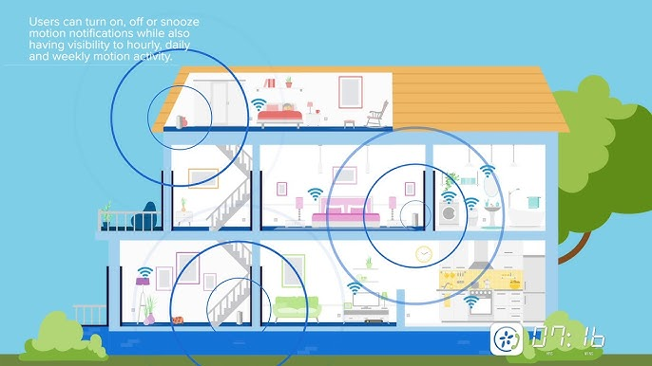
802.11bf Sensing
  802.11bf is developing a protocol for environmental sensing
  Measurements that can be used to monitor environmental conditions and changes
  E.g., people movement, number of people present, room occupancy, etc.
  Built on sounding (beamforming) waveforms
  Does not define use of the measurements; just defines the sounding exchange and transfer of channel state information
WLAN sensing uses PHY and MAC features of IEEE 802.11 stations to obtain measurements that may be useful to estimate features of objects in an area of interest.
  Features = Range, velocity, angular, motion, presence or proximity, gesture, etc.
  Objects = Human, animal, etc.
  Area of interest = Room, car, enterprise, etc.

Slide 14
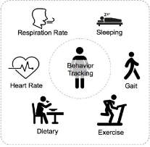


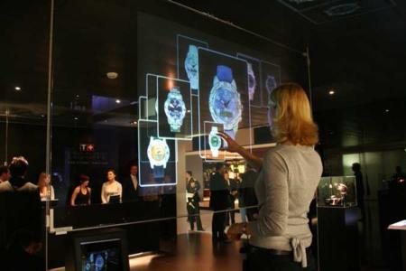


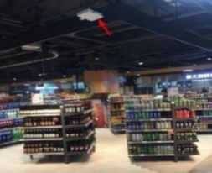

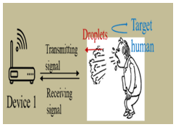
802.11bf Sensing
Use cases:
1. Smart home
2. Presence and proximity detection
3. Gesture recognition
4. Gaming control
5. Vital signs / Liveness
6. Location in store
7. Audio with user tracking (Follow-me sound)
8. Sneeze sensing

Slide 15
802.11bh Randomized and Changing MAC addresses (RCM)
A MAC address is a physical hardware identifier that is assigned by the hardware manufacturer to a
network device (Ethernet, Wireless, and Bluetooth as examples)
To protect user privacy, there is a growing trend to randomize the client device’s MAC address, which
can otherwise be “snooped” by third-parties and used to track the user’s movements and potentially actions.
  MAC address randomization can undermine the network’s ability to steer the device to the best connection point, or to recognize the device and provide differentiated access in secure environments, pay-for-bandwidth scenarios, etc.

Slide 16
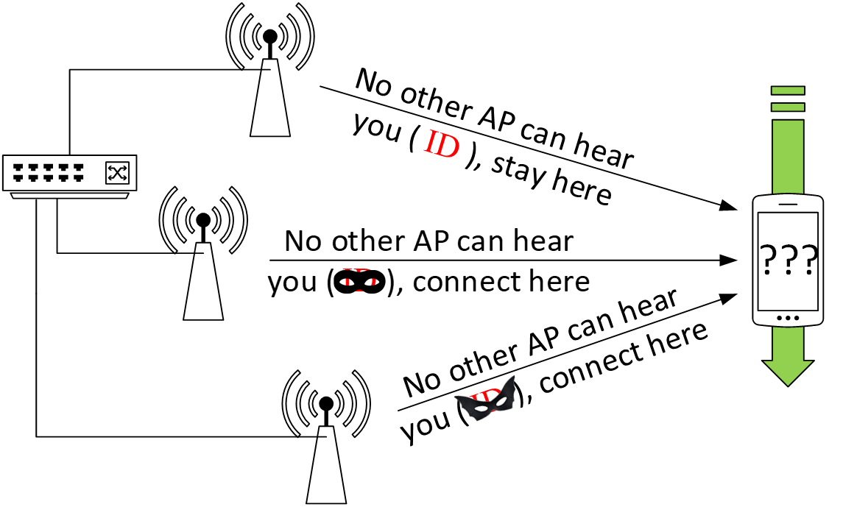
802.11bh Randomized and Changing MAC addresses (RCM)
Client Steering Use Case
  Impacted use cases include:
  Steering a client device to the best connection point
  Recognizing the device, to provide personalized home automation
  Access to pay services, or differentiated levels of service
  Customer support and troubleshooting
Notes:
Use cases in which use of a Randomized MAC address impacts network operation include
Steering a client, and following, as listed on the left.
The figure shows the example client steering use case, in which the network instructs the client device to stay
or connect to a particular AP. The network needs to be able to correlate the device’s communications (probes, etc), while at the same time, the identity is not
visible to passive observation.

Slide 17
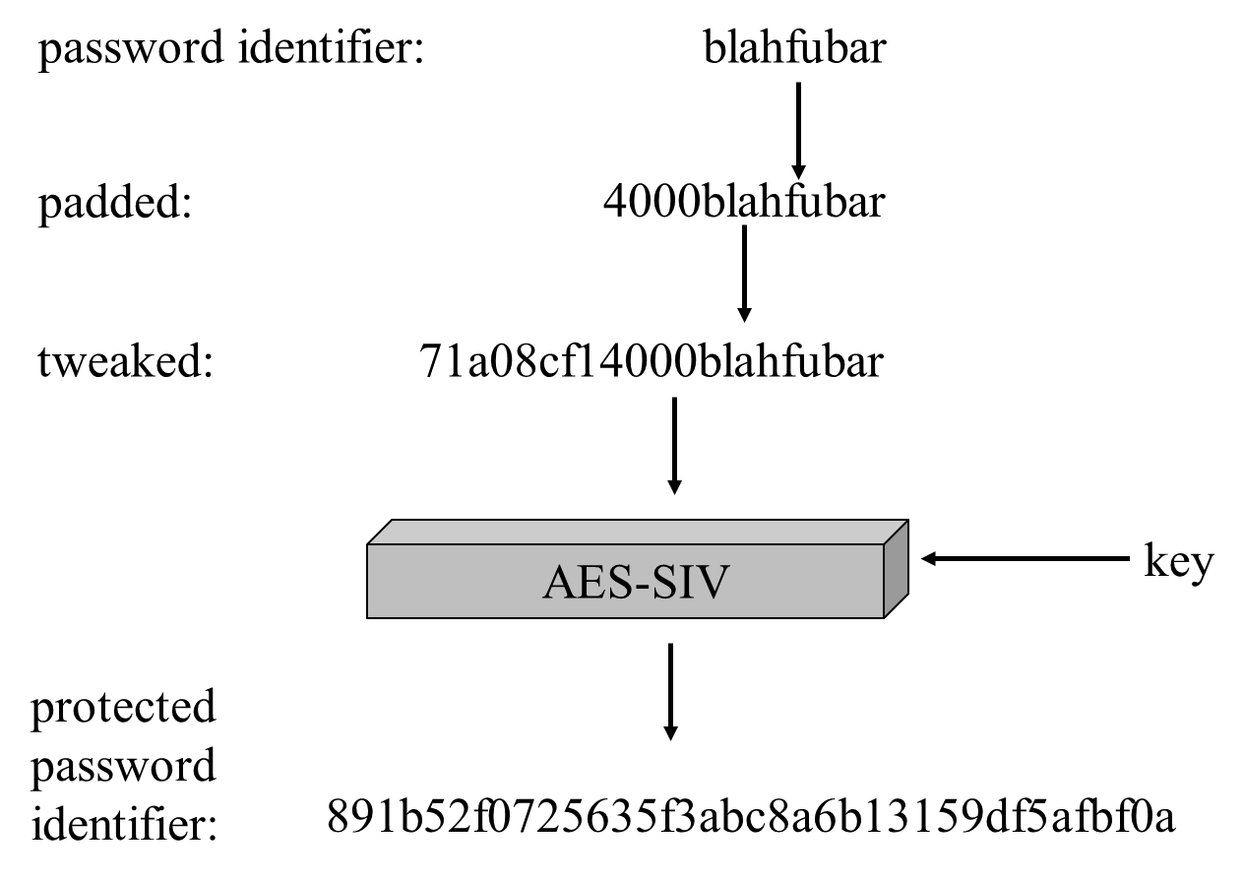
802.11bi Enhanced Data Privacy (EDP)
Defines new mechanisms to improve user privacy
Today, IEEE Std 802.11aq-2018 defines MAC address randomization and specific requirements to prevent device tracking using passive observation of PHY, MAC protocol fields.
To ensure continued growth and support for IEEE Std 802.11, this project is investigating additional enhancements for user privacy solutions applicable to 802.11.
Privacy of Password (WPA3)
Privacy of Password Identifier

Slide 18
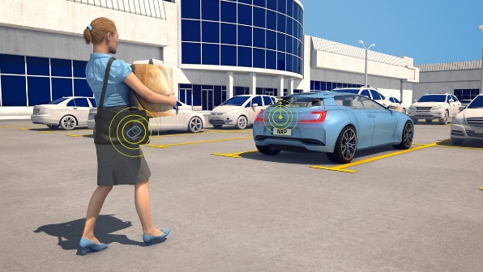
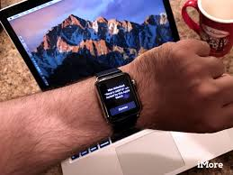
802.11bk 320 MHz Positioning (320P)
Increase the accuracy of 802.11 based location and proximity determination
WLAN standardization roadmap towards 0.1m accuracy levels in real world scenarios
Based on P802.11be 320 MHz channelization and waveforms, reuses the 802.11be PHY
Takes advantage of WLAN spectrum availability in the <7GHz band and the superior 802.11 link budget
Attractive for device-to-device, improved self-locating network accuracy, keyless entry and engine-start use cases

Slide 19
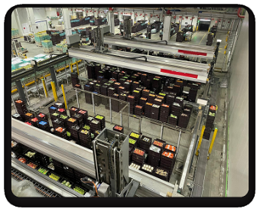

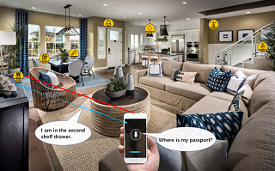
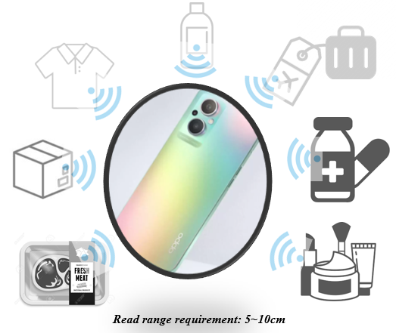
802.11bp Ambient Power Transmission (AMP)
AMbient Power (AMP) Communication provisions a mechanism enabling battery-free applications which is especially important to low-power IoT applications. This will not only help users within home, enterprise and public access markets, but also assist manufacturers and operators to provide common components and services for IEEE 802.11 customers
AMP IoT applications cover various scenarios:
  Smart manufacturing
  Logistics/warehouse
  Close range AMP tag reading
  Fresh food supply chain
  Smart home
  Smart Grid

Slide 20
802.11bp Ambient Power Transmission (AMP)
802.11bp defines MAC/PHY enhancements from mainstream 802.11 standards and amendments to provide an ambient power communication solution in WLAN by:
  defining ambient power transmission in both S1G and 2.4 GHz bands.
  defining wireless power transmission protocol in S1G
  supporting both bistatic and monostatic transmission
  defining mechanisms for coexistence between 802.11bp compliant devices and legacy 802.11 devices.
A technical report on AMP in WLAN was developed by an earlier AMP group.

Slide 21
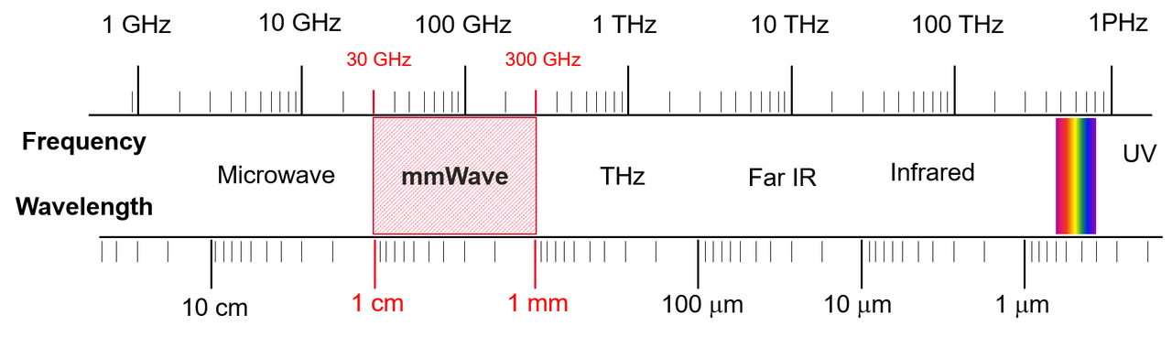
802.11bq Integrated mmWave (IMMW)
Expected to start work as task group in February 2025
Simplify 42-71 GHz band operation to reduce implementation cost
Previous generations (802.11ad/ay/aj) assumed stand alone operation
  Re-design with multi-band support in mind
Improvements expected:
  More architectural reuse from low band PHY
  Eliminate control PHY by taking advantage of multi-link; e.g., sector sweep beamforming directed through low band channel
This project is particularly relevant to China where 6 GHz band operation is not available

Slide 22
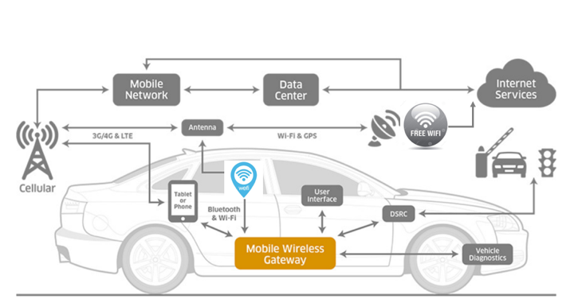
802.11 AUTOmotive group
The AUTO TIG is developing a report on the automotive use of Wi-Fi
The automotive industry wants to use Wi-Fi opportunistically to
  Update software, maps, etc.
  Get updates on traffic conditions
  Serve internet connectivity to occupants using Wi-Fi
  Connect to mobile devices
The report will provide
  Use cases and requirements
  Key performance indicators
  Technical approaches and 802.11 standard gaps in the areas
  such as protocols in association & authentication,
  seamless AP handover,
  optimized roaming algorithm etc.
  Alternative solutions

Slide 23

802.11 Enhanced Light Communications (ELC) group
IEEE Std 802.11bb-2023 added light communications (LC) to 802.11
The ELC study group is preparing a project outline to enhance this work
For example,
  Add multi-link support
  Support for underwater operation
With approval a task group is expected to start work in May 2025

Slide 24
802.11 AI / ML Artificial Intelligence/ Machine Learning group
  Use of AI/ML for 802.11 applications is an active area of work in the research community.
  Current applications focus on performance improvement parameter selection for channel access control and link adaptation, multi-user parameters, channel usage
  Focus of the 802.11 AIML group is to:
  Describe use cases for Artificial Intelligence/Machine Learning (AI/ML) applicability in 802.11 systems and investigate the technical feasibility of features enabling support of AI/ML.

Slide 25
Thank You
Questions ?

